Slide 1
Treinamento Dev Team
LACE – Transformação Ágil B3
Treinamento Dev Team

Slide 2
Considerações finais

Slide 3

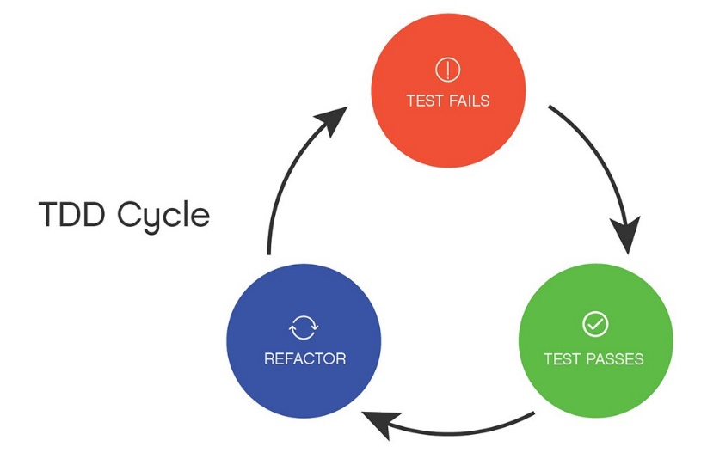
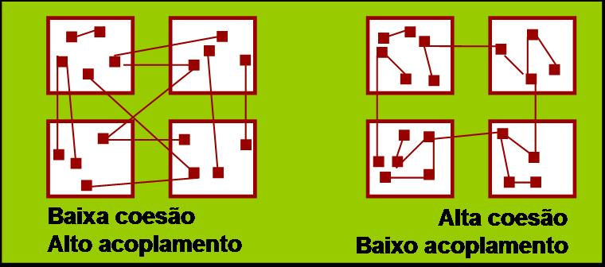
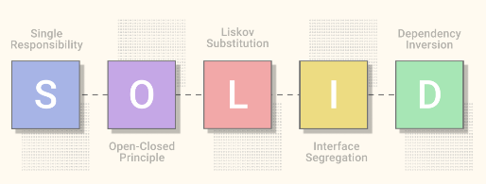


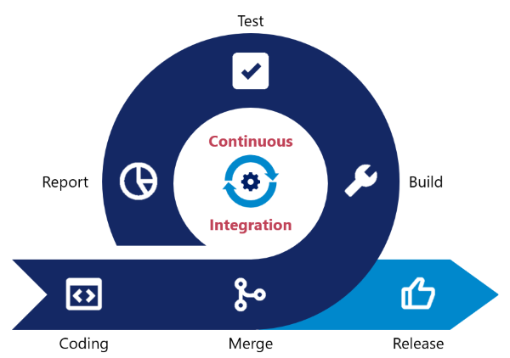


Considerações Finais
Refatoração/ Clean Code
Métricas

Slide 4
Confluence B3

Slide 5
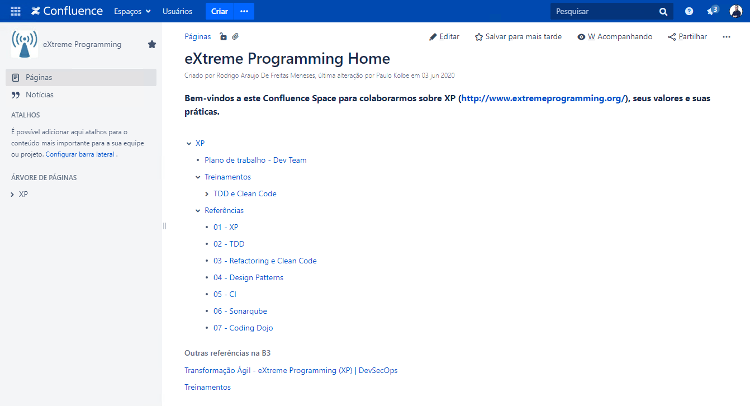
CONFLUENCE B3
XP Home: https://confluence.intraservice.corp/x/Pxy1Gw

Slide 6
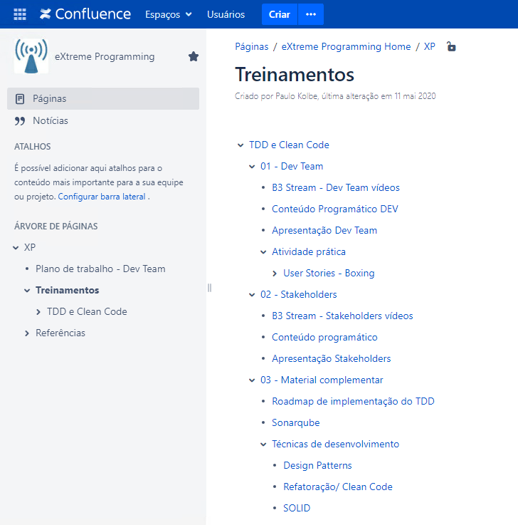
CONFLUENCE B3
Treinamentos: https://confluence.intraservice.corp/x/pCC1Gw

Slide 7

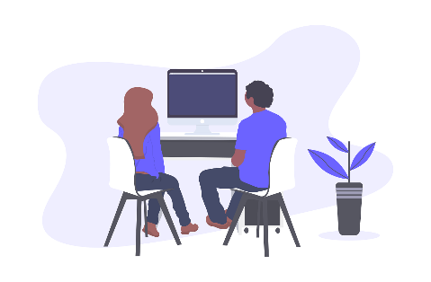
CONFLUENCE B3
Dev Team: https://confluence.intraservice.corp/x/qiC1Gw
Stakeholders: https://confluence.intraservice.corp/x/rCC1Gw
Material complementar: https://confluence.intraservice.corp/x/wCC1Gw
Refatoração/ Clean Code: https://confluence.intraservice.corp/x/aya1Gw

Slide 8


Treinamento Dev Team lace@b3.com.br

